Slide 1

A Project Review-I Presentation on
Election Result Prediction in Partial Fulfillment of Final Year Computer Engineering Course- Project Stage-I by
Pranav Bhople (121B1D024), Dnyaneshwari Katkar (121B1D049), Sahil Dhanwani (121B1D052), Vaibhav Indure (121B1D053) (A. Y. 2024-25) Under the guidance of Prof. Anand Birajdar Department of Computer Engineering(Regional Language) PCET’s Pimpri Chinchwad College of Engineering

Slide 2
Contents
Problem Statement
Motivation
Objectives
Scope and Feasibility
Project Requirements
Literature Survey
References
Literature Review
Project Planning
Project Design
Modern tools and Technologies
Result of 50% work
Conclusion

Slide 3
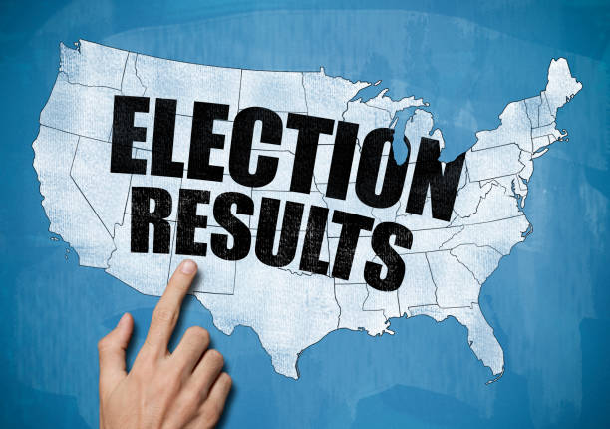
Problem Statement
Predicting election results in India based on candidate data involves analyzing various factors such as past election performance, demographic influence, political trends, and public sentiment.

Slide 4
Motivation
Elections play a crucial role in shaping the democratic structure of India. Traditional election predictions rely heavily on opinion polls and expert analysis, which may sometimes be biased or inaccurate. With the rise of big data and machine learning, there is an opportunity to create a more precise and objective prediction model. By leveraging historical election data, candidate profiles, and real-time public sentiment, this study aims to improve election forecasting accuracy. The insights from such predictions can help political parties in strategizing campaigns, aid researchers in studying voter trends, and enhance transparency in the electoral process.

Slide 5
Objectives
Objectives:
Predict Election Outcomes – Utilize candidate data and past trends to forecast election results.
Analyze Key Factors – Identify the influence of various factors such as criminal cases, assets, and education on election results.
Enhance Voter Awareness – Provide insights into candidate backgrounds for informed decision-making.
Leverage Data-Driven Insights – Use statistical models and machine learning to improve prediction accuracy.
Assist Political Strategies – Help parties understand voting patterns and optimize their campaigns.

Slide 6
Scope & Feasibility
Scope:
Candidate Data Analysis – Evaluating personal, financial, and political attributes of candidates.
Voting Pattern Recognition – Understanding trends based on past election data and demographics.
Geographical Coverage – State-wise and constituency-level predictions.
Machine Learning Integration – Using algorithms to refine predictions and detect anomalies.
Impact Assessment – Measuring how various candidate factors affect voter preferences.
Feasibility:
Technical Feasibility –
Availability of historical election data.
Use of AI/ML techniques for data processing and prediction.
Operational Feasibility –
Requires collaboration with political analysts and data experts.
Economic Feasibility –
Low-cost implementation using open-source tools (Python, R, etc.).
Can be monetized via consulting for political parties or media houses.

Slide 7
Project Requirements
Software Requirements
Languages & Tools: Python, Jupyter Notebook, VS Code
Libraries: NumPy, Pandas, Scikit-learn, Plotly, Seaborn, Matplotlib
OS: Windows/Linux/macOS
Database: CSV/Excel files
Hardware Requirements
Processor: Intel i5 / AMD Ryzen 5 or higher
RAM: 8GB (16GB recommended)
Storage: 100GB+ SSD preferred
GPU (Optional): NVIDIA CUDA-enabled for faster ML training

Slide 8
Project Requirements
Functional Requirements
Data Handling: Load, clean, and preprocess election data
Model Training: Train and optimize ML models (K-Nearest Neighbors, Logistic Regression, etc.)
Prediction & Visualization: Forecast results and generate insights with charts
Evaluation: Assess accuracy, precision, and performance metrics
Non-Functional Requirements
Scalability: Handle large datasets efficiently
Performance: Optimized for quick predictions
Reliability: Robust model validation for accuracy
Usability: Intuitive visualizations for easy interpretation
Security: Secure data handling

Slide 9
Literature Survey
First 5 most relevant papers, explain in detail in the format given in next slide)

Slide 10
Reference 1 | DeLuca, Kevin. "A Model of the 2024 Presidential Election with Candidate Quality." (2024).
Objectives | Provide a more accurate forecast of the 2024 U.S. presidential election, focusing on both the national two-party Democratic vote share and the Electoral College results.
Proposed Solution | DeLuca builds upon Fair's (2009) economic fundamentals model by adding a candidate quality differential. This differential is derived from newspaper endorsements, as detailed in DeLuca's 2024 study on measuring candidate quality using local newspaper endorsements.
Results | The model predicts that Kamala Harris would secure 52.5% of the two-party popular vote, which is approximately 1.5 to 2 percentage points higher than other forecasts and polling averages at the time.
Advantages | The integration of candidate quality aims to improve the precision of election forecasts, potentially capturing dynamics that purely economic models might miss.
Limitations | The model's measure of candidate quality is based on newspaper endorsements, which may not fully capture public perceptions or the multifaceted nature of candidate appeal.

Slide 11
Reference 2 | Basyar, Goran Fadhil. SUPPORTING PREPARATION FOR INDONESIA'S 2024 ELECTION. Diss. TILBURG UNIVERSITY, 2024.
Objectives | Analyze the existing electoral system in Indonesia to identify potential challenges and areas for improvement.
Proposed Solution | Conduct a thorough evaluation of the current electoral processes, including voter registration, campaign regulations, and voting mechanisms.
Results | By engaging various stakeholders, the research fosters a greater understanding of the importance of collaborative efforts in election preparation.
Advantages | Recommendations are specifically tailored to Indonesia's socio-political landscape, enhancing their applicability and effectiveness.
Limitations | While the study offers valuable recommendations, actual implementation may face obstacles such as political resistance or resource constraints.

Slide 12
Reference 3 | DHADA, PUTU SUKMA DHARMALAKSANA. PREDICTING PRESIDENTIAL ELECTIONS IN INDONESIA USING MACHINE LEARNING BASED ON CANDIDATE SOCIAL MEDIA PERFORMANCE. Diss. Nusa Putra University, 2023.
Objectives | Develop a machine learning model to predict election outcomes based on social media metrics.
Proposed Solution | Employ supervised machine learning algorithms to train predictive models using the engineered features.Assess the model's performance using historical election data to ensure its predictive accuracy.
Results | The developed machine learning model achieves a notable accuracy in predicting election outcomes based on social media metrics.
Advantages | Utilizing social media data allows for timely insights into public opinion and candidate popularity.
Limitations | Social media users may not represent the entire voting population, potentially introducing bias into the analysis.

Slide 13
Reference 4 | Mantika, Alisya Mutia, Agung Triayudi, and Rima Tamara Aldisa. "Sentiment Analysis on Twitter Using Naïve Bayes and Logistic Regression for the 2024 Presidential Election." SaNa: Journal of Blockchain, NFTs and Metaverse Technology 2.1 (2024): 44-55.
Objectives | Compare the effectiveness of Naïve Bayes and Logistic Regression algorithms in classifying sentiments.
Proposed Solution | Clean the data by removing noise such as URLs, special characters, and stop words, and perform tokenization. Convert textual data into numerical features using techniques like Term Frequency-Inverse Document Frequency (TF-IDF). Apply Naïve Bayes and Logistic Regression algorithms to classify the sentiments expressed in the tweets.
Results | Both Naïve Bayes and Logistic Regression models effectively classified sentiments in the collected tweets.
Advantages | The study offers a comparison between two machine learning algorithms, highlighting their respective strengths in sentiment analysis.
Limitations | The complexity of language, including sarcasm and slang, can pose challenges for accurate sentiment classification.

Slide 14
Reference 5 | Hamdani, Agus Umar, et al. "Comparison of K-NN, SVM, and Random Forest Algorithm for Detecting Hoax on Indonesian Election 2024." Jurnal Nasional Pendidikan Teknik Informatika: JANAPATI 13.1 (2024).
Objectives | Compare the performance of K-NN, SVM, and Random Forest algorithms in tweets detection.
Proposed Solution | Implement K-NN, SVM, and Random Forest algorithms to classify the tweets based on the extracted features. Assess the performance of each model using metrics such as accuracy, precision, recall, and F1-score to determine their effectiveness in detecting hoaxes.
Results | Random Forest achieved higher accuracy and better performance metrics compared to the other two algorithms.
Advantages | By comparing multiple algorithms, the study identifies the most effective method for hoax detection in the given context.
Limitations | While Random Forest performed best in this study, its effectiveness may vary with different datasets or in different contexts.

Slide 15
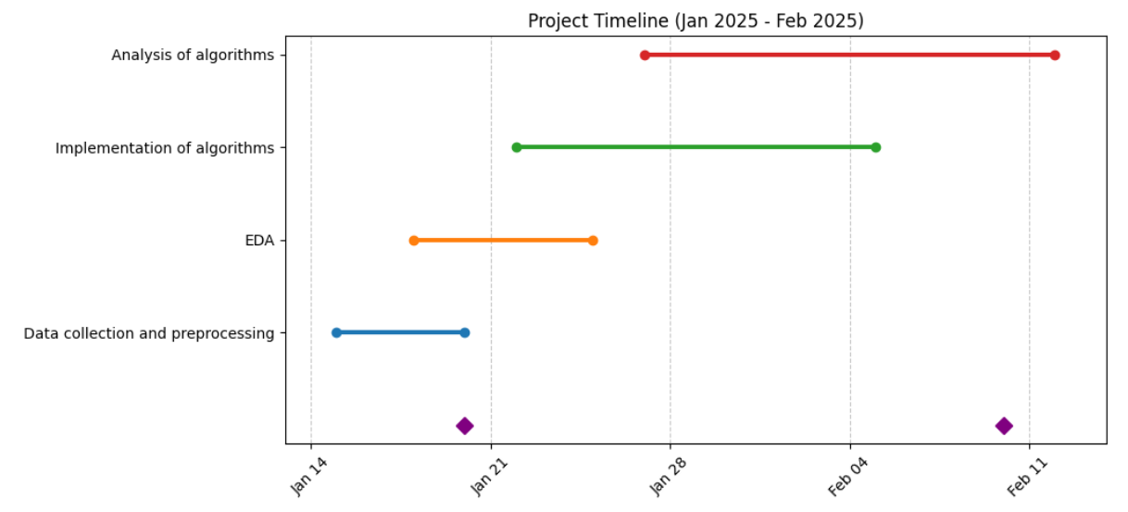
Project planning: Timeline Diagram

Slide 16
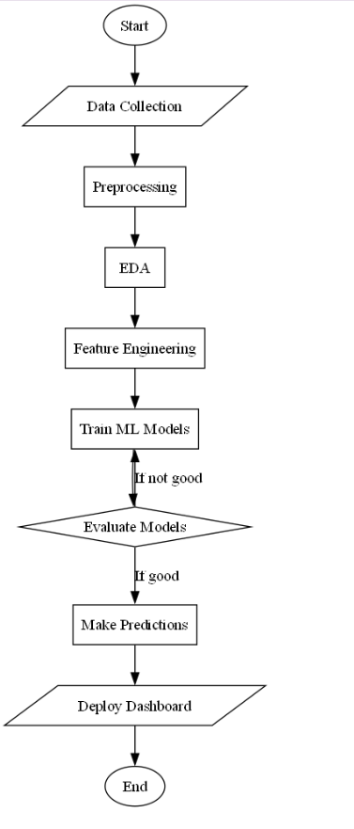
Flowchart

Slide 17
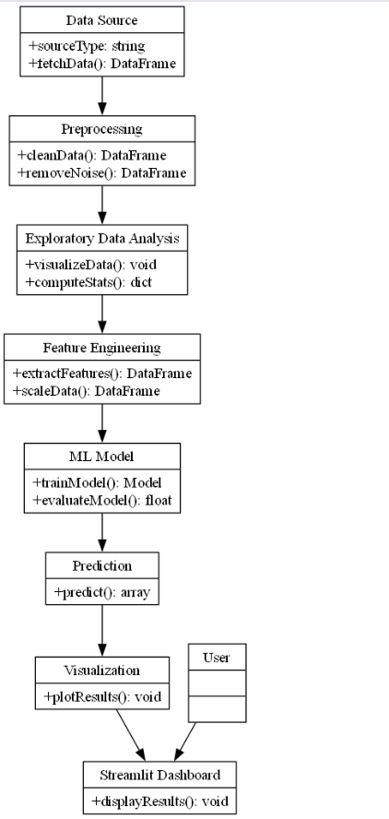
UML diagram

Slide 18
Modern Tools & Techniques selected for project development
Programming Languages – Python (for data processing and ML modeling).
Libraries & Frameworks –
Data Manipulation – NumPy, Pandas
Data Visualization – Matplotlib, Seaborn, Plotly
Machine Learning Models – Scikit-learn, KNN, Logistic Regression
Data Resampling – SMOTE
Data Scaling & Encoding – MinMaxScaler, OrdinalEncoder, LabelEncoder
Model Evaluation – Sklearn metrics (accuracy, precision, recall, etc.)
Development Tools – Jupyter Notebook, VS Code
Operating System – Windows
Database – CSV/Excel files

Slide 19
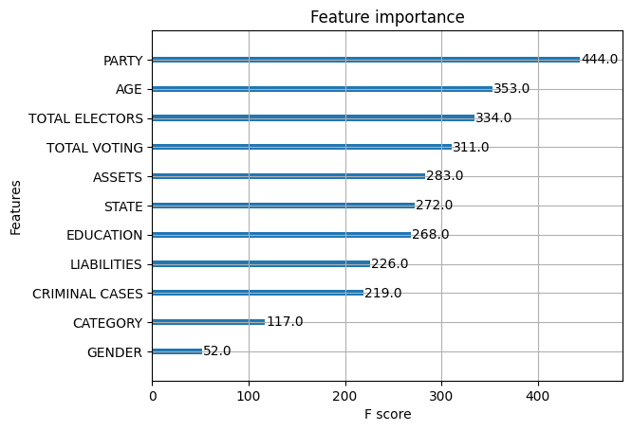
Results of 50% work

Slide 20
Conclusion
In this project, we successfully analyzed election data to predict election outcomes using various machine learning models. Our analysis highlighted key factors such as criminal cases, assets, and education that influence election results. Among all models tested, K-Nearest Neighbors (KNN) achieved the highest accuracy of 94%, demonstrating its effectiveness in capturing voting patterns. These insights can enhance voter awareness and assist political parties in optimizing their campaign strategies through data-driven decision-making.

Slide 21
References
For example (Follow given format):
1. Gnoying Feng et.al “Experimental research on vertical axis wind turbine” IEEE school of energy and power engineering, vol. 978,no.1, 2009.
2. G.M.Hasan Shaharirar “Design and construction of vertical axis wind turbine” IEEE International form on strategic technology, vol. 978, no. 1, pp 326-329, Oct 2014.
3. S.Sathiyamoorthy et.al, “Hybrid energy harvesting using Piezoelectric materials, automatic rotational solar panel, vertical axis wind turbine”, International conference on modelling, optimisation and computing, IEEE, Vol. 38, no. 10, pp 843-852, July 2005.
4. Atif Shahzad et. Al. “ Performance of a Vertical axis wind turbine under accelerating and decelerating flows” Second international through-life engineering service conference, Elsevier, Vol. 11, no. 1, pp 311-316, 2013.
5. Sahishnu R shah et. Al., “ Design, modelling and economic performance of a vertical axis wind turbine,” Energy Reports, Elsevier, Vol 11, pp. 619-623, 2018.

Slide 22
Thank you

